Slide 1
Basics in Continuous Gas Analysis Calibration with Test gases
Help
eLearning, BU Measurement Products
Notes:
Welcome to the ABB eLearning program for Basics in Continuous Gas Analysis. This course module will familiarize you with some of the issues that are important to the analyzers in operation, particularly when calibrating using test gases. If you need assistance in navigating this module, click the help button at any time. To view the speaker notes, select the speaker notes button in the lower right. Also, if you like, you can download a printable version of the presentation by clicking the “Attachments” button. And now: Enjoy the course!

Slide 2

Learning objectives
Calibration with test gases
Help
After completing this module, you will be able to…
Understand why we need test gases for our analyzers
Understand what "calibration" means
Please be aware that this presentation contains one or more copyrighted picture(s). You are only allowed to use these images for the purposes of this presentation.
Notes:
After completing this module, you will be able to
understand why our analyzers need test gases and which test gases they need.
You will understand what "calibration" means

Slide 3
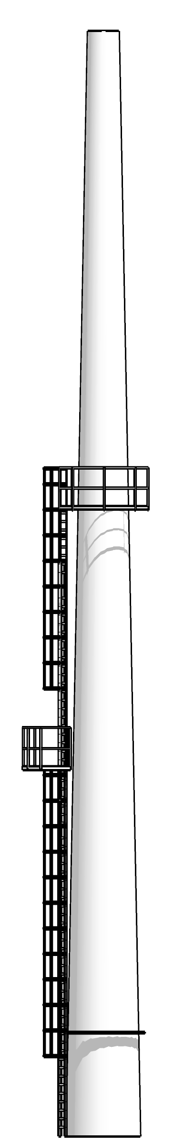
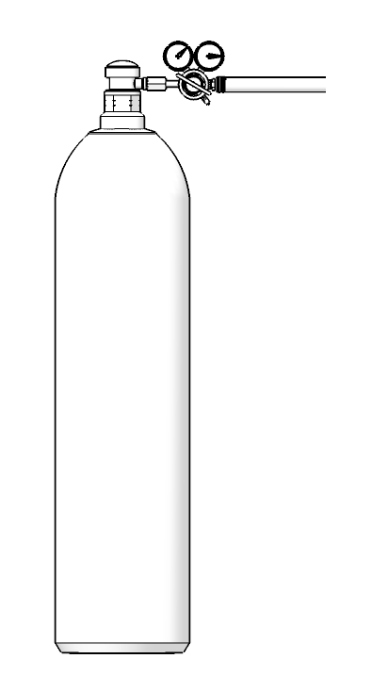
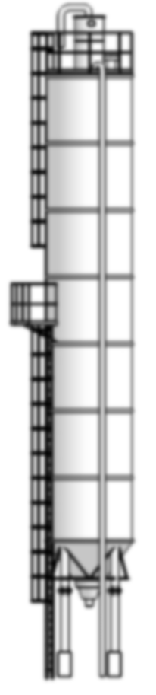
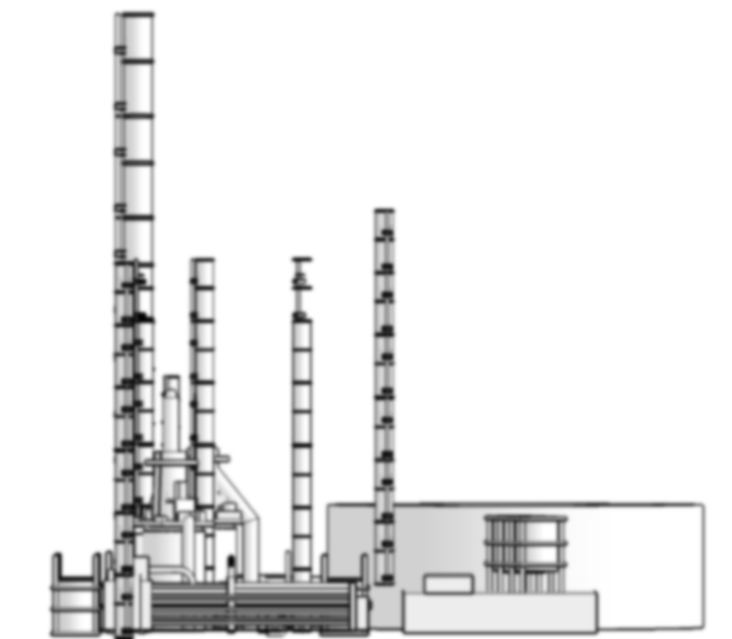
The gas analysis installation in operation
Help
SYNTHETIC
N₂
AMBIENT
ZERO GAS
Notes:
An analyzer and a sampling system
have to be installed, put into operation and maintained.
The need for maintenance depends on the application, but a periodic check or re-adjustment of the zero point and / or the sensitivity is required.
For these checks / validation / adjustments test gases are required.
In general, the zero point must be checked with a gas that is free of measurement components. This is our ZERO-GAS.
Typical zero gases are N₂, synthetic air and ambient air
To check the sensitivity, we need a suitable span gas (test gas)

Slide 4
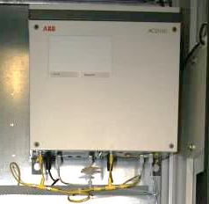
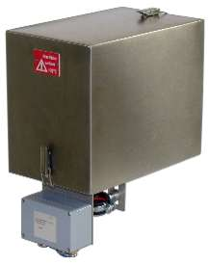
Validation, adjustment
Help
An important issue for an analyzer system is the regular adjustment or validation with test gases.
The certified test gases are used as a reference for our gas analyzers.
A periodic adjustment compensates any altering effects in the analyzer system.
Typically, we inject test gases at the probe or before the cooler or directly into the analyzer.
The test gases depend on the individual analyzer configuration.
Typically, we need suitable zero- and span gases.
The quality of the test gases is important for the accuracy of the measurement.
ZERO GAS
Notes:
An important issue for an analyzer system
is the regular adjustment (calibration) or validation with test gases.
The certified test gases are used as a reference for our gas analyzers.
A periodic adjustment compensates any altering effects in the analyzer system. Therefore, we need the option of injecting test gases anywhere in the sampling system.
Typically, we inject test gases at the probe (heated filter) or before the cooler or directly into the analyzer.
The test gases that are used depend on the individual analyzer configuration.
Typically, we need zero- and span gases.
The quality of the test gases is important for the accuracy of the measurement. The reference must always be better than the expected accuracy.

Slide 5
Zero gases Nitrogen
Help
A zero-gas must be free of measurement components.
Nitrogen (N₂) is the most typical zero gas.
The quality is expressed by a number.
N₂ 5.0 means 99,999 Vol% purity →10 ppm impurities, e.g.
O₂ < 3 ppm
H₂O < 5 ppm
TC < 0.2 ppm
N₂ 4.0 means 99.99 Vol% → 100 ppm impurities
N₂ 4.0 is less expensive than N₂ 5.0.
It depends on the analyzer configuration, which quality is sufficient
ZERO GAS
N₂
ppm
1000000
10
/
impurities
ppm
1000000
100
/
impurities
Notes:
A zero-gas must be free of measurement components.
Nitrogen (N₂) is the most typical zero gas. It is available in different qualities.
The quality is expressed by a number:
N₂ 5.0 means 99.999 Vol% purity or 10 ppm impurities. e.g.
O₂ < 3 ppm
H₂O < 5 ppm
TC < 0.2 ppm
N₂ 4.0 means 99.99 Vol% or 100 ppm impurities
N₂ 4.0 is less expensive than N₂ 5.0.
It depends on the analyzer configuration, which quality is sufficient.

Slide 6
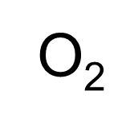


Zero gases Synthetic air
Help
Zero gas synthetic air
20.5 Vol% ± 0.5% / N₂
Different qualities for synthetic air, e.g.
Synthetic air, free of TOC, ≥ 99,999 Vol.%
H₂O < 5 ppm
TOC < 0.1 ppm
CO₂ < 0.5 ppm
NOx < 0.1 ppm
Synthetic air is available with or without a defined amount of .
Synthetic air with a certificate is more expensive. Please check carefully which quality is needed!
SYNTHETIC
O₂
N₂
Notes:
Synthetic air can be used as zero-gas.
Synthetic air is an oxygen / nitrogen mixture with an oxygen level of 20…21 Vol%
Different qualities for synthetic air, e.g.
Synthetic air, free of TOC, ≥ 99,999 Vol.%
H₂O < 5 ppm
TOC < 0.1 ppm
CO₂ < 0.5 ppm
NOx < 0.1 ppm
Synthetic air is also available with a defined amount of oxygen.
Synthetic air with a certificate is more expensive. Please check carefully which quality is needed!

Slide 7
Zero gases Ambient air
Help
Ambient air can be used as zero gas, but the ambient air must be free of measurement components.
Ambient air consists of:
Nitrogen 78.09 Vol %
Oxygen 20.94 Vol %
Argon 0.93 Vol %
CO₂ approx. 380 ppm
Neon 18 ppm
Helium 5.2 ppm
Methane 1.76 ppm
Cryptone 1.1 ppm
And some other components in ppb or ppt – amount
AMBIENT
contains a different moisture level (dew point).
needs to be supplied prior to the cooler, to get a constant dew point of 3ºC.
Notes:
Ambient air can be used as zero gas, but the ambient air must be free of measurement components.
Ambient air consists of
Nitrogen 78.09 Vol %
Oxygen 20.94 Vol %
Argon 0.93 Vol %
CO₂ approx. 380 ppm
Neon 18 ppm
Helium 5.2 ppm
Methane 1.76 ppm
Cryptone 1.1 ppm
And some other components in ppb or ppt – amount
Ambient air always contains a different moisture level (dew point). To work with a constant ambient air, the ambient air needs to be supplied prior to the cooler, to get a constant dew point of 3ºC.

Slide 8
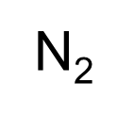
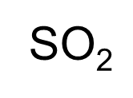
Test gases Span gases
Help
The test gases are supplied in test gas cylinders.
They come with a certificate, e.g. 497 ppm CO ± 2% balanced in .
The carrier gas is mainly . The test gases are completely dry; see the declaration of 5.0
Sometimes it is useful to have different components in one test gas cylinder, e.g. 497 ppm CO, 256 ppm NO, 345 ppm , balanced in .
When the individual components react with each other, it is not possible to fill them in one cylinder, e.g. and NH₃.
The expiration date is also stipulated on the certificate.
N₂
CO
NO
SO₂
497
256
345
ppm
ppm
ppm
expiration date
Notes:
To check or correct the sensitivity from the analyzer we need a span gas.
These span gases (test gases) are supplied in test gas cylinders.
They come with a certificate, e.g. 497 ppm CO + 2% balanced in N₂.
The carrier gas is mainly N₂. The test gases are completely dry (just 1 or 2 ppm H₂O); see the declaration of N₂ 5.0
Sometimes it is useful to have different components in one test gas cylinder, e.g. 497 ppm CO,
256 ppm NO,
345 ppm SO₂, balanced in N₂.
When the individual components react with each other, it is not possible to fill them in one cylinder, e.g. SO₂ and NH₃. There are also some other reasons not to fill up blend gases, for example some analyzers need individual test gases for any internal adjustments.
The expiration date is also stipulated on the certificate.

Slide 9
What does “calibration” mean?
Help
Zero gas
N₂
Sensor
e.g. Uras
No IR-absorption
0 mg/m³ CO
Specific IR-absorption
100 mg/m³ CO
0,070
Test gas, e.g.
100 mg/m³ CO/N₂
0,060
0,050
0,040
0,030
The Test gas-concentration is related to 0ºC, 1013hPa, dry
0,020
0,010
0,000
4000
3500
3000
2500
2000
1500
1000
Notes:
What does “calibration” actually mean?
By the way, we do not calibrate!
We adjust the individual sensor signal of the instrument towards a test gas standard.
In our example we get an absorption signal from our Uras-module.
The absorption is our sensor signal.
The reference, which is used for calibration, must be sufficient for the analyzers' specification and we must rely in the values printed on the bottle certificate.
If the concentration is indicated in mg/m³, it is typically related to 0ºC, 1013hPa. BUT BE CAREFUL! It can be different in different parts of the world! A bad or a wrong reference gives us bad or wrong analyzer results. Gas analyzers generally do not measure any absolute values.

Slide 10
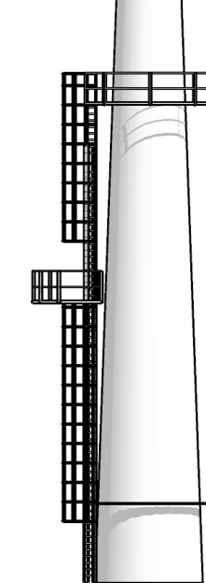
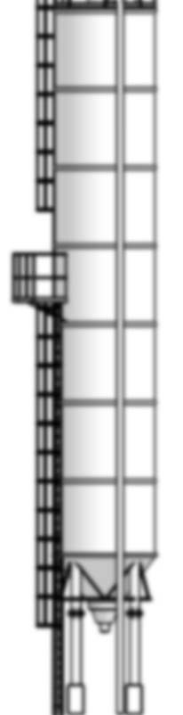
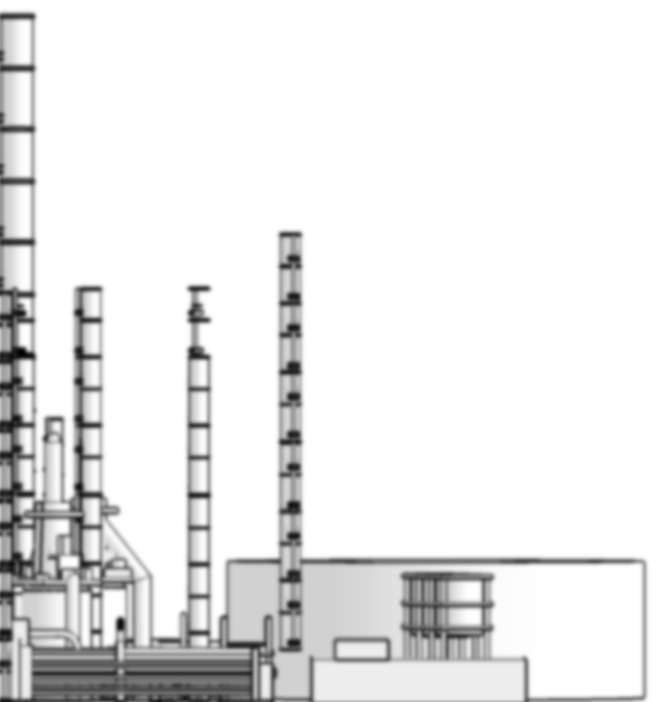
Calculation of the emission
Help
Gas analyzer
CO, NO, SO₂,…
Emission calculator
mg/m³
Gas analyzer
O₂
Vol%
Moisture analyzer
H₂O
Vol%
Dust analyzer
mg/m³
Pressure, temperature, flow from stack
Notes:
For emission monitoring,
all measurement components such as CO, NOx and SO₂ must be calculated and normalized according to some reference parameters:
The extractive cold, dry analyzers read mg/m³ related to 0ºC, 1013hPa, dry, because the used reference gas is indicated in mg/m³ (0ºC, 1013hPa). They have to be normalized only to a certain oxygen level.
The extractive hot, wet analyzers read mg/m³ related to 0ºC, 1013hPa. They have to be normalized to a certain oxygen level and to the moisture content.
The in-situ analyzers read mg/m³. They have to be normalized to a certain oxygen level, to the moisture content and to the pressure and temperature in the stack.
To calculate the total emission, a day average value is calculated for the components and calculated with the total stack flow. The calculation takes place in the data acquisition system (emission calculator).

Slide 11

Summary
Have you understood everything so far?
Help
Yes click (continue)
What have you learned so far?
Our cold, dry extractive analyzers indicate the values according to the used reference (test gas) in ppm or mg/m³, related to 0ºC, 1013hPa.
The readings have to be normalized to a certain oxygen level.
The hot wet analyzers measure in a wet matrix.
The wet readings also have to be normalized with the moisture content and oxygen level.
The in-situ analyzers need normalization to the pressure, temperature, moisture and oxygen level in the stack.
The total emission is calculated from the day average values with the mass flow from the stack.
No click (repeat)
Please be aware that this presentation contains one or more copyrighted picture(s). You are only allowed to use these images for the purposes of this presentation.
Notes:
What have you learned from this module?
Our dry extractive analyzers indicate the values according to the used reference in ppm or mg/m³, typically related to 0ºC, 1013hPa.
The readings have to be normalized to a certain oxygen level.
The hot wet analyzers can measure in a wet matrix.
The wet readings also have to be normalized with the moisture content and oxygen level.
The in-situ analyzers need normalization to the pressure, temperature, moisture and oxygen level in the stack.
The total emission is calculated from the day average values with the mass flow from the stack.
Have you understood everything so far? If so, click the "continue" button. Otherwise, click "No" if you‘d like to repeat this topic.

